Slide 1
Requirements Validation
Chapter 4

Slide 2
Validation objectives
Certifies that the requirements document is an acceptable description of the system to be implemented
Checks a requirements document for
  Completeness and consistency
  Conformance to standards
  Requirements conflicts
  Technical errors
  Ambiguous requirements

Slide 3
Analysis and validation
Analysis works with raw requirements as elicited from the system stakeholders
  “Have we got the right requirements” is the key question to be answered at this stage
Validation works with a final draft of the requirements document i.e. with negotiated and agreed requirements
  “Have we got the requirements right” is the key question to be answered at this stage
WATCH OUT!!!
Many times, in class tests, for example,
students use “buzzwords” such as
“requirements right” or “right requirements”,
without giving examples,
without explaining, or
without convincing the staff.
They do not secure maximum marks.
Analysis: Focuses on the relevance
of the requirements.
Validation: Focuses on the accuracy
of the details.
N.H. Madhavji

Slide 4
Verification vs. Validation -- NHM
Verify the *subject* requirements against some established truth (e.g., laws of gravity, actual space and volume of a location, facts and figures, etc.)
  NHM: You may got the requirement “correct” but it may not be Valid!
Validate the *subject* requirement by asking the stakeholders who desire the system if *they* are satisfied with the requirement.
  NHM: So, you may have a “satisfaction” reply but this does not guarantee that the technical specifics of the requirements are “correct” (which may require a specialist to approve, e.g., the value of gravitational pull).
N.H. Madhavji

Slide 5
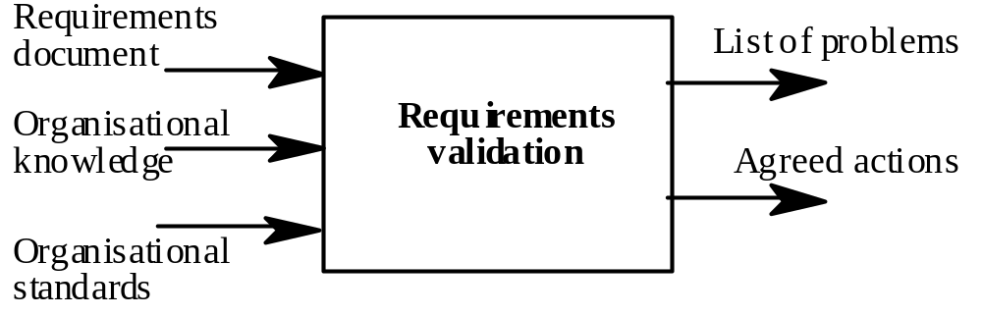
Validation inputs and outputs
What are
the
OUTPUTS?
What are the
INPUTS?

Slide 6
Validation inputs
Requirements document
  Should be a complete version of the document, not an unfinished draft. Formatted and organised according to organisational standards
Organisational knowledge
  Knowledge, often implicit, of the organisation which may be used to judge the realism of the requirements
Organisational standards
  Local standards e.g. for the organisation of the requirements document

Slide 7
Validation outputs
Problem list
  List of discovered problems in the requirements document
Agreed actions
  List of agreed actions in response to requirements problems. Some problems may have several corrective actions; some problems may have no associated actions

Slide 8
Requirements reviews
A group of people read and analyse the requirements, look for problems, meet and discuss the problems and agree on actions to address these problems

Slide 9
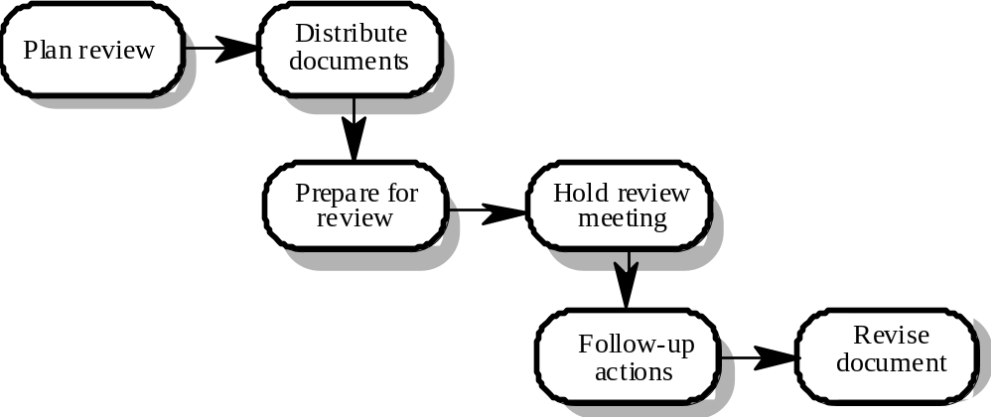
Requirements review process

Slide 10
Review activities
Plan review
  The review team is selected and a time and place for the review meeting is chosen.
Distribute documents
  The requirements document is distributed to the review team members
Prepare for review
  Individual reviewers read the requirements to find conflicts, omissions, inconsistencies, deviations from standards and other problems.

Slide 11
Review activities
Hold review meeting
  Individual comments and problems are discussed and a set of actions to address the problems is agreed.
Follow-up actions
  The chair of the review checks that the agreed actions have been carried out.
Revise document
  The requirements document is revised to reflect the agreed actions. At this stage, it may be accepted or it may be re-reviewed
There are emerging tools for conducting On-line reviews. These could help here!

Slide 12
Problem actions
Requirements clarification
  The requirement may be badly expressed or may have accidentally omitted information which has been collected during requirements elicitation.
Missing information
  Some information is missing from the requirements document. It is the responsibility of the requirements engineers who are revising the document to discover this information from system stakeholders.
Requirements conflict
  There is a significant conflict between requirements. The stakeholders involved must negotiate to resolve the conflict.
Unrealistic requirement
  The requirement does not appear to be implementable with the technology available or given other constraints on the system. Stakeholders must be consulted to decide how to make the requirement more realistic.

Slide 13
Requirements Clarification: Example
Reqt: There shall be a barrier at the entrance of the car park.
Clarification:
Define “barrier”, e.g.:
  porter’s kiosk
  bar type
  floor spikes
  What is the barrier structure, dimensions,
  placement, etc. ?
  What is its action behaviour?
N.H. Madhavji

Slide 14
Missing Information: Example
No mention of the hours of operation of the barrier. Do not assume 24/7/365.
No mention of safety issues.
N.H. Madhavji

Slide 15
Requirements Conflict: Example
Reqt.: For emergency purposes, the South entrance to the car park shall always be open.
Conflict:
Drivers can sneek into, or exit from, the car park
through the South entrance/exit.
N.H. Madhavji

Slide 16
Unrealistic Requirement: Example
100% reliability of the barrier operation is required at all times.
Hidden camera shall detect private vehicles exiting through the emergency exit and report to the administration.
  “Private vs. Public” detection capability.
  High cost of operation
N.H. Madhavji

Slide 17
Pre-review checking
Frankly, I do not think
that finding missing
requirements is always
simple. It may need
multiple views to realise this.
Reviews are expensive because they involve a number of people spending time reading and checking the requirements document
This expense can be reduced by using pre-review checking where one person checks the document and looks for straightforward problems such as missing requirements, lack of conformance to standards, typographical errors, etc.
Document may be returned for correction or the list of problems distributed to other reviewers

Slide 18
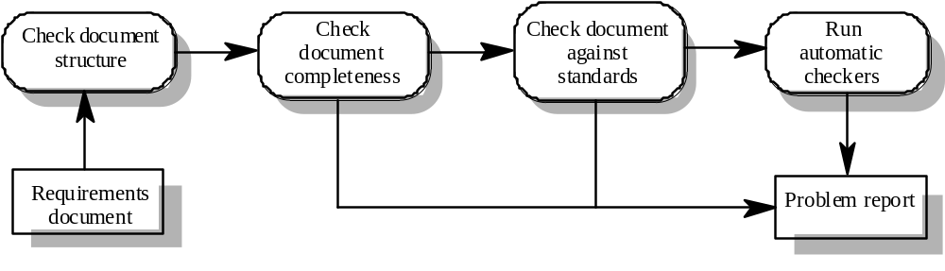
Pre-review checking

Slide 19
Review team membership
Reviews should involve a number of stakeholders drawn from different backgrounds
  People from different backgrounds bring different skills and knowledge to the review
  Stakeholders feel involved in the RE process and develop an understanding of the needs of other stakeholders
Review team should always involve at least a domain expert and an end-user

Slide 20
Review checklists
Understandability
  Can readers of the document understand what the requirements mean?
Redundancy
  Is information unnecessarily repeated in the requirements document?
Completeness
  Does the checker know of any missing requirements or is there any information missing from individual requirement descriptions?
Ambiguity
  Are the requirements expressed using terms which are clearly defined? Could readers from different backgrounds make different interpretations of the requirements?

Slide 21
Review checklists
Consistency
  Do the descriptions of different requirements include contradictions? Are there contradictions between individual requirements and overall system requirements?
Organisation
  Is the document structured in a sensible way? Are the descriptions of requirements organised so that related requirements are grouped?
Conformance to standards
  Does the requirements document and individual requirements conform to defined standards? Are departures from the standards, justified?
Traceability
  Are requirements unambiguously identified, include links to related requirements and to the reasons why these requirements have been included?

Slide 22
Checklist questions
Is each requirement uniquely identified?
Are specialised terms defined in the glossary
Does a requirement stand on its own or do you have to examine other requirements to understand what it means?
Do individual requirements use the terms consistently
Is the same service requested in different requirements? Are there any contradictions in these requests?
If a requirement makes reference to some other facilities, are these described elsewhere in the document?
Are related requirements grouped together? If not, do they refer to each other?

Slide 23
Requirements problem example
“4. EDDIS will be configurable so that it will comply with the requirements of all UK and (where relevant) international copyright legislation. Minimally, this means that EDDIS must provide a form for the user to sign the Copyright Declaration statement. It also means that EDDIS must keep track of Copyright Declaration statements which have been signed/not-signed. Under no circumstances must an order be sent to the supplier if the copyright statement has not been signed.”

Slide 24
Problems
Incompleteness
  What international copyright legislation is relevant?
  What happens if the copyright declaration is not signed?
  If a signature is a digital signature, how is it assigned?
Ambiguity
  What does signing an electronic form mean? Is this a physical signature or a digital signature?
Standards
  More than 1 requirement. Maintenance of copyright is one requirement; issue of documents is another

Slide 25
Prototyping
Prototypes for requirements validation demonstrate the requirements and help stakeholders discover problems
Validation prototypes should be complete, reasonably efficient and robust. It should be possible to use them in the same way as the required system
User documentation and training should be provided

Slide 26
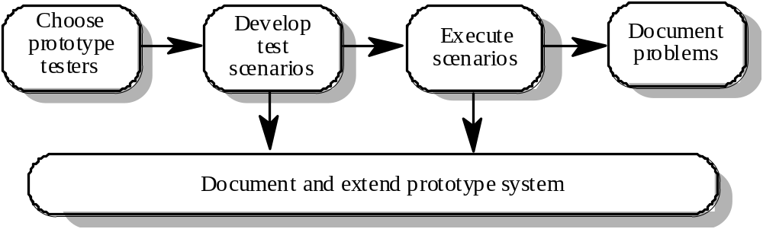
Prototyping for validation

Slide 27
Prototyping activities
Choose prototype testers
  The best testers are users who are fairly experienced and who are open-minded about the use of new systems. End-users who do different jobs should be involved so that different areas of system functionality will be covered.
Develop test scenarios
  Careful planning is required to draw up a set of test scenarios which provide broad coverage of the requirements. End-users shouldn’t just play around with the system as this may never exercise critical system features.
Execute scenarios
  The users of the system work, usually on their own, to try the system by executing the planned scenarios.
Document problems
  Its usually best to define some kind of electronic or paper problem report form which users fill in when they encounter a problem.

Slide 28
User manual development
Writing a user manual from the requirements forces a detailed requirements analysis and thus can reveal problems with the document
Information in the user manual
  Description of the functionality and how it is implemented
  Which parts of the system have not been implemented
  How to get out of trouble
  How to install and get started with the system

Slide 29
Model validation
Validation of system models is an essential part of the validation process
Objectives of model validation
  To demonstrate that each model is self-consistent
  If there are several models of the system, to demonstrate that these are internally and externally consistent
  To demonstrate that the models accurately reflect the real requirements of system stakeholders
Some checking is possible with automated tools
Paraphrasing the model is an effective checking technique

Slide 30
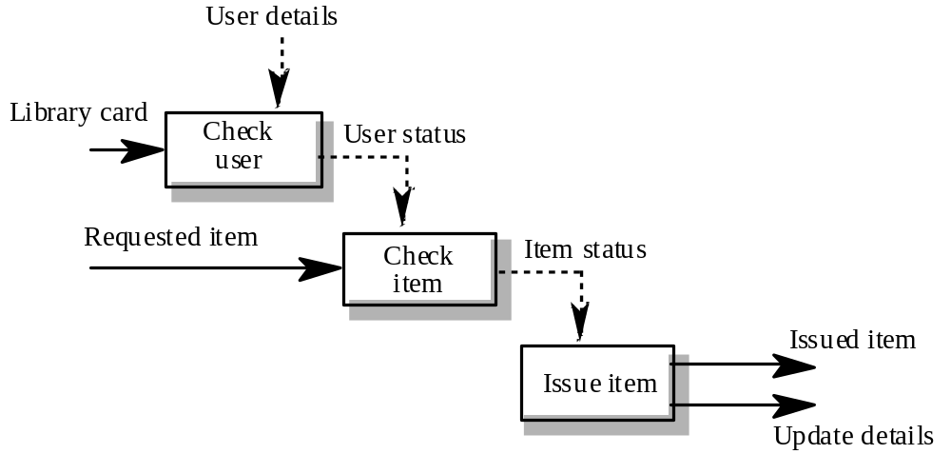
Data-flow diagram for Issue

Slide 31
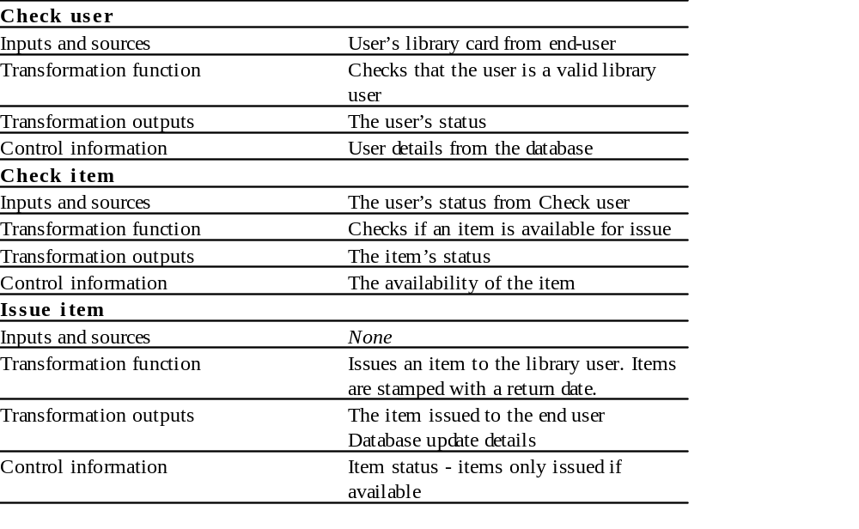
Paraphrased description

Slide 32
Requirements testing
Each requirement should be testable i.e. it should be possible to define tests to check whether or not that requirement has been met.
Inventing requirements tests is an effective validation technique as missing or ambiguous information in the requirements description may make it difficult to formulate tests
Each functional requirement should have an associated test

Slide 33
Requirements Testing – global perspective
Gather
Requirements
Basic
Reqts.
Develop or
Evolve the
System
Test the
System
System
Testable
Reqts.
(ideally)
Test
cases
Reqts. Changes
Reqts.
Test
cases
Develop
Test cases
N.H. Madhavji

Slide 34
Test case definition
What usage scenario might be used to check the requirement?
Does the requirement, on its own, include enough information to allow a test to be defined?
Is it possible to test the requirement using a single test or are multiple test cases required?
Could the requirement be re-stated to make the test cases more obvious?

Slide 35
Test record form
The requirement’s identifier
  There should be at least one for each requirement.
Related requirements
  These should be referenced as the test may also be relevant to these requirements.
Test description
  A brief description of the test and why this is an objective requirements test. This should include system inputs and corresponding outputs.
Requirements problems
  A description of problems which made test definition difficult or impossible.
Comments and recommendations
  These are advice on how to solve requirements problems which have been discovered.

Slide 36
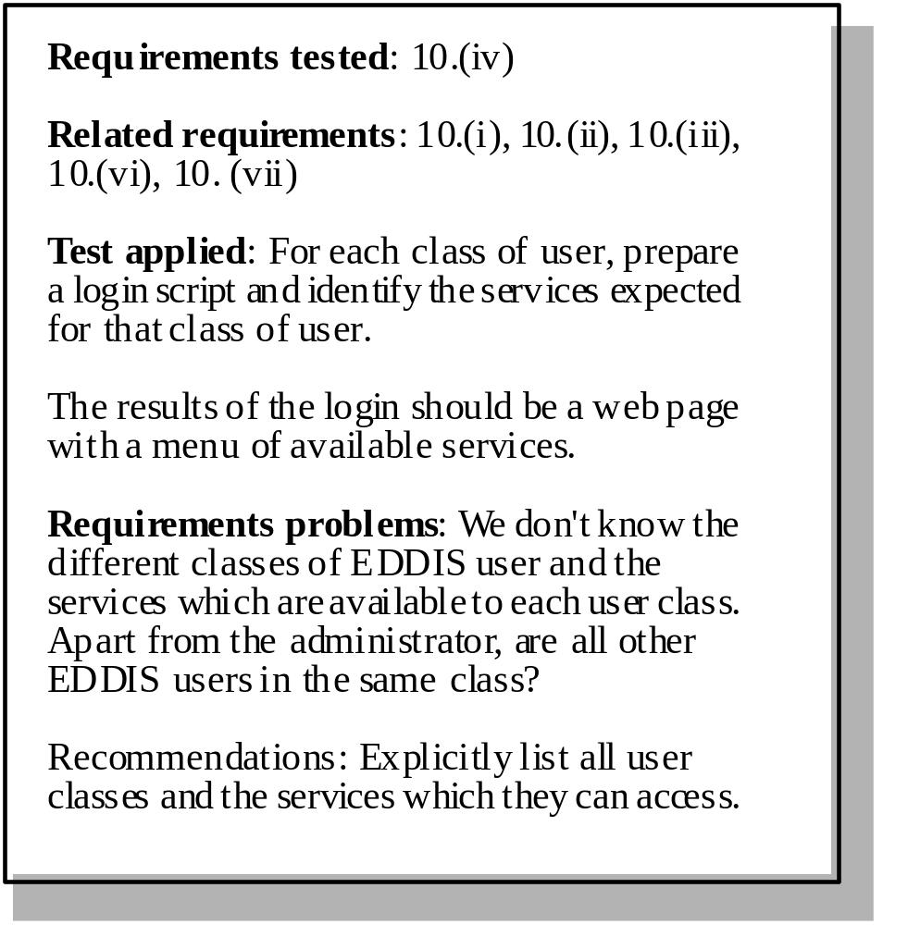
Requirements test form
10 (iv) When users access EDDIS, they will be presented with
web pages and all services available to them.

Slide 37
Hard-to-test requirements
Preventative mechanisms in system design may help (e.g., redundancy)
System requirements
  Requirements which apply to the system as a whole. In general, these are the most difficult requirements to validate irrespective of the method used as they may be influenced by any of the functional requirements. Tests, which are not executed, cannot test for non-functional system-wide characteristics such as usability.
Exclusive requirements
  These are requirements which exclude specific behaviour. For example, a requirement may state that system failures must never corrupt the system database. It is not possible to test such a requirement exhaustively.
Some non-functional requirements
  Some non-functional requirements, such as reliability requirements, can only be tested with a large test set. Designing this test set does not help with requirements validation.
Reliability tests need a long operational time for the system to determine this attribute.
N.H. Madhavji

Slide 38
Key points
Requirements validation should focus on checking the final draft of the requirements document for conflicts, omissions and deviations from standards.
Inputs to the validation process are the requirements document, organisational standards and implicit organisational knowledge. The outputs are a list of requirements problems and agreed actions to address these problems.
Reviews involve a group of people making a detailed analysis of the requirements.
Review costs can be reduced by checking the requirements before the review for deviations from organisational standards. These may result from more serious requirements problems.

Slide 39
Key points
Checklists of what to look for may be used to drive a requirements review process.
Prototyping is effective for requirements validation if a prototype has been developed during the requirements elicitation stage.
Systems models may be validated by paraphrasing them. This means that they are systematically translated into a natural language description.
Designing tests for requirements can reveal problems with the requirements. If the requirement is unclear, it may be impossible to define a test for it.

